Slide 1
HEART DISEASE PREDICTION SYSTEM ARTIFICIAL INTELLIGENCE
FACULTY INCHARGE:
DR. K. SURESH
TEAM MEMBERS:
SOHAN SAMPATH RA2011026010321
KARTIK JAIN RA2011026010335
VAIBHAV DUTTA MATHUR RA2011026010343

Slide 2
Abstract
Heart disease is a major cause of mortality worldwide. Early diagnosis and prediction of heart disease can significantly improve patient outcomes. In this study, we propose a heart disease prediction system using machine learning techniques.
The system takes input from various medical tests and demographic information, such as age, gender, and blood pressure, to predict the likelihood of a patient developing heart disease. We evaluate the performance of the system using several evaluation metrics, including accuracy, sensitivity, and specificity.
If our heart disease prediction system achieves high accuracy it can be a useful tool for healthcare professionals in predicting and preventing heart disease.

Slide 3
Contents
1 | Introduction | 4
2 | Literature Survey | 5 – 6
3 | System Architecture | 7 – 9
4 | Requirements | 10 – 11
5 | Methodology | 12 – 13
6 | Comparing with other Algorithms | 14 – 15
7 | Code | 16 – 22
8 | Dataset | 23 – 24
9 | Result | 25
10 | Conclusion | 26
11 | References | 27

Slide 4
Introduction
A Heart Disease Prediction System can be beneficial for several reasons in real life scenarios. One of the most important reasons is that it can help identify individuals who are at high risk for heart disease, allowing for early intervention and treatment to prevent potentially life-threatening conditions.
For example, imagine a primary care physician who sees a patient with several risk factors for heart disease, such as a family history of heart disease, high blood pressure, and elevated cholesterol levels. By using a Heart Disease Prediction System, the physician can input the patient's data and receive a prediction of their likelihood of developing heart disease. Based on this prediction, the physician can then recommend lifestyle changes, such as a healthy diet and exercise, or medication to help lower the patient's risk of heart disease.
Additionally, a Heart Disease Prediction System can be used in population health management programs to identify high-risk groups and develop targeted interventions to prevent heart disease. For example, a public health department may use a Heart Disease Prediction System to analyze health data from a community and identify areas where heart disease rates are highest. The department can then use this information to develop and implement prevention strategies, such as community-based education programs or policy changes to encourage healthier lifestyles

Slide 5
Literature Survey
Alizadehsani et al. (2017) evaluated the performance of six machine learning algorithms, including logistic regression, decision tree, k-nearest neighbor, artificial neural network, support vector machine, and random forest, in predicting the presence of coronary artery disease. The authors used a dataset of 303 patients with 13 features, including age, gender, blood pressure, and cholesterol level. The results showed that logistic regression and support vector machine achieved the highest accuracy of 85.8% and 84.5%, respectively, while decision tree and k-nearest neighbor had lower accuracy.
Krittanawong et al. (2018) reviewed the use of artificial intelligence in precision cardiovascular medicine. The authors highlighted the potential of machine learning algorithms in predicting heart disease and improving clinical decision-making. They discussed various applications of machine learning in cardiovascular medicine, including image analysis, risk prediction, and drug development.
Liu et al. (2020) conducted a systematic review of studies that used machine learning algorithms to predict coronary artery disease. The authors identified 32 studies that met the inclusion criteria and evaluated the performance of various machine learning algorithms, including logistic regression, support vector machine, and neural network. The results showed that most studies achieved high accuracy in predicting coronary artery disease, with logistic regression and support vector machine being the most commonly used algorithms.

Slide 6
Prasad et al. (2020) conducted a systematic review of 24 studies that evaluated the performance of machine learning algorithms in predicting coronary artery disease. The authors found that most studies achieved high accuracy in predicting heart disease, with logistic regression and support vector machine being the most commonly used algorithms. The authors highlighted the need for further research to validate the performance of these algorithms in real-world settings and to address the challenges of data heterogeneity and bias.
Zhang et al. (2019) used a deep learning approach to predict coronary artery disease risk factors. The authors used a dataset of 27,000 patients with 23 features, including demographic and medical data. The results showed that the deep learning algorithm achieved an accuracy of 87.7% in predicting the presence of coronary artery disease, outperforming logistic regression and support vector machine.
In summary, machine learning algorithms, especially logistic regression and support vector machine, have shown promising results in predicting heart disease. However, further research is needed to validate the performance of these algorithms in real-world settings and to address the challenges of data heterogeneity and bias. The potential of deep learning algorithms in improving heart disease prediction also warrants further investigation.

Slide 7
System Architecture
Data source: This component is responsible for providing the data required by the system. This may include data from electronic health records, medical devices, or user inputs.
Data preprocessing module: This component is responsible for cleaning, transforming, and preprocessing the data to make it suitable for analysis.
Feature engineering module: This component is responsible for selecting and engineering features from the preprocessed data that can be used to predict the risk of heart disease.
Model training module: This component is responsible for training a predictive model using the selected features.
Model evaluation module: This component is responsible for evaluating the performance of the predictive model.
User interface module: This component is responsible for providing a user-friendly interface for the prediction system. This may include a web application, mobile application, or other interface that allows users to input their data and receive a risk assessment for heart disease.

Slide 8
Deployment module: This component is responsible for deploying the system to a production environment, where it can be accessed by users.
The heart disease prediction system architecture may also include other components, such as a database for storing patient data, a security module for protecting user data, and a monitoring module for tracking system performance.
Overall, the architecture of a heart disease prediction system is designed to facilitate the collection, processing, analysis, and communication of patient data, in order to provide accurate and timely risk assessments for heart disease.

Slide 9
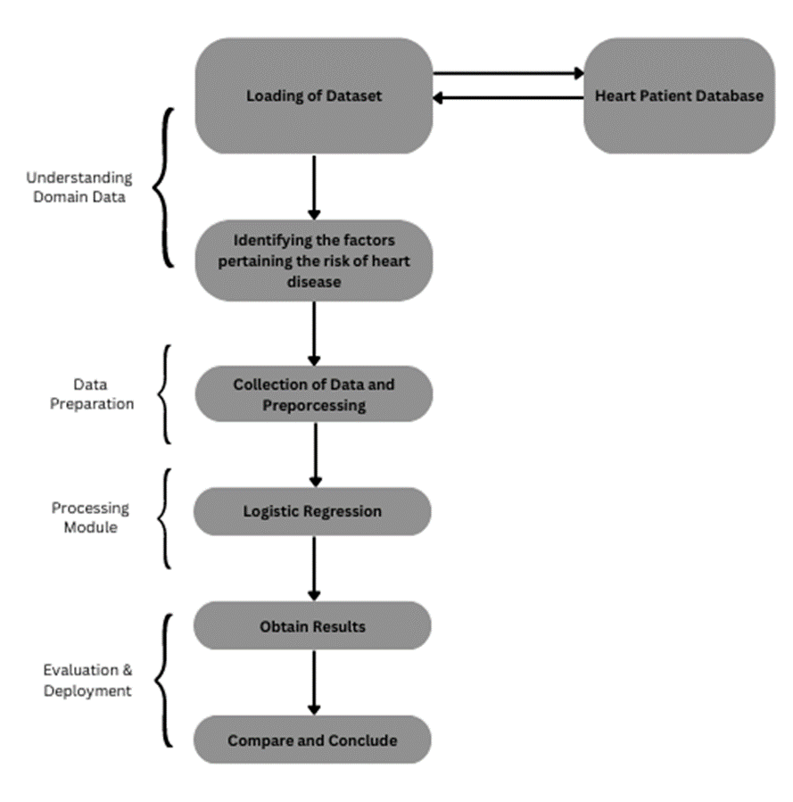
System Architecture Diagram

Slide 10

Requirements
Hardware Requirements:
Processor: A modern processor with multiple cores (e.g., Intel i5 or i7) is recommended to speed up computations.
RAM: The system should have enough RAM to handle the dataset and any intermediate computations. At least 8 GB of RAM is recommended, but more may be required for larger datasets.
Storage: The system should have enough storage space to store the dataset and any intermediate computations. A solid-state drive (SSD) is recommended for faster read/write speeds.
Graphics Card: A graphics processing unit (GPU) can be used to speed up computations for some machine learning algorithms. However, this is not required for all algorithms and may depend on the specific implementation.

Slide 11
Software Requirements:
Operating System: The heart disease prediction system can be developed and deployed on various operating systems, such as Windows, macOS, or Linux.
Programming Language: The system can be developed using various programming languages, such as Python or R, which are commonly used for machine learning tasks.
Machine Learning Libraries: There are many machine learning libraries available for Python and R, such as scikit-learn, TensorFlow, and Keras, that can be used to implement the heart disease prediction system.
Database: A database may be used to store the heart disease dataset and any intermediate computations. Various database management systems (DBMS) are available, such as MySQL or PostgreSQL.

Slide 12
Methodology
Data collection: The first step in developing a heart disease prediction system is to collect the necessary data. This may include demographic information, medical history, lifestyle factors, and clinical test results.
Data preprocessing: The collected data needs to be cleaned and preprocessed to ensure that it is accurate and ready for analysis. This may involve techniques such as removing missing or inconsistent data, normalization, and feature scaling.
Feature engineering: Once the data has been cleaned and preprocessed, the next step is to extract relevant features that can be used to predict the risk of heart disease. This may involve selecting the most important variables, combining variables to create new features, or transforming variables to better capture the underlying patterns in the data.
Model development: The next step is to develop a model that can predict the risk of heart disease based on the extracted features. Logistic regression is one of the common algorithms used for this task, but other algorithms such as decision trees, random forests, and support vector machines may also be used.

Slide 13
Model evaluation: After developing the model, it needs to be evaluated to assess its performance. This may involve splitting the data into training and testing sets and using metrics such as accuracy, sensitivity, specificity, or area under the receiver operating characteristic curve (AUC-ROC) to evaluate the model's performance.
Deployment: Finally, the developed and evaluated model can be deployed as a heart disease prediction system. This may involve integrating the model into a user-friendly interface, such as a web application or mobile app, that allows users to input their data and receive a personalized risk assessment for heart disease.
Overall, the methodology of a heart disease prediction system involves collecting and preprocessing data, extracting relevant features, developing and evaluating a predictive model, and deploying the model as a user-friendly system for predicting the risk of heart disease.

Slide 14
Comparison with Other Algorithms
Logistic regression, decision trees, and random forests are all popular algorithms used in machine learning. Each algorithm has its own strengths and weaknesses, and the choice of algorithm depends on the specific problem at hand. Here are some reasons why logistic regression may be preferred over decision trees and random forests for heart disease prediction:
Interpretability: Logistic regression produces a linear equation that can be easily understood and interpreted by humans. In contrast, decision trees and random forests can be more difficult to interpret, especially for large and complex datasets.
Regularization: Logistic regression can be regularized to prevent overfitting, which can occur when the model is too complex and fits the noise in the data instead of the underlying pattern. Decision trees and random forests can also be regularized, but the choice of hyperparameters can be more difficult and time-consuming.
Performance: Logistic regression is generally faster and requires less memory than decision trees and random forests, especially for large datasets. Logistic regression can also handle a large number of features, whereas decision trees and random forests may struggle with high-dimensional datasets.

Slide 15
Non-linear Relationships: Logistic regression can handle non-linear relationships between input variables and the output variable using polynomial or interaction terms. However, decision trees and random forests may be better suited for capturing non-linear relationships between variables.
Overall, logistic regression is a better choice for heart disease prediction if interpretability, regularization, and computational efficiency are important considerations.

Slide 16
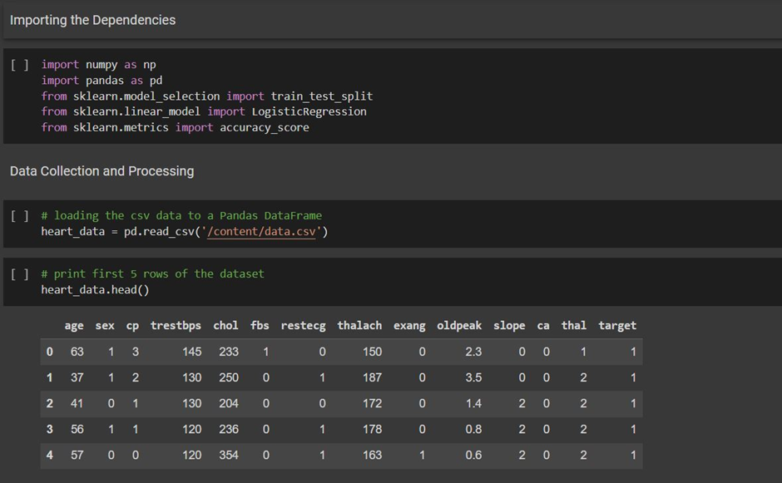
Code

Slide 17
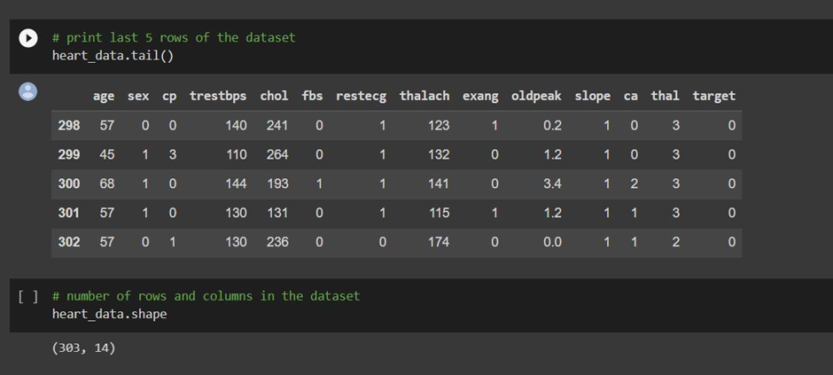
Code

Slide 18
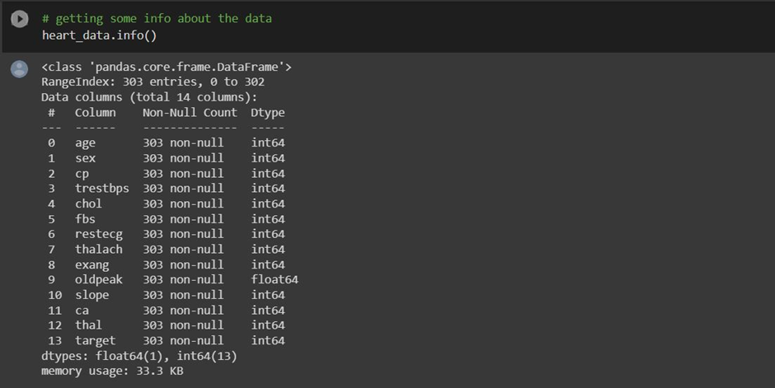
Code

Slide 19
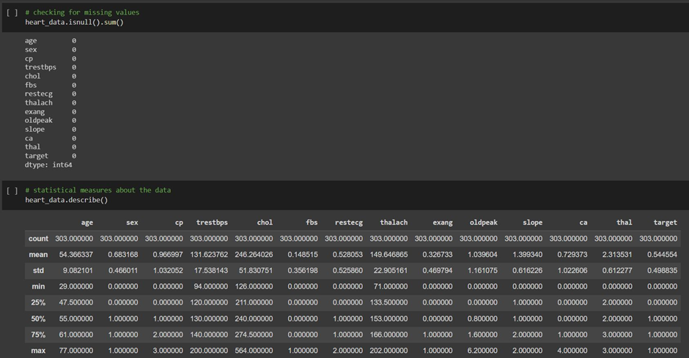
Code

Slide 20
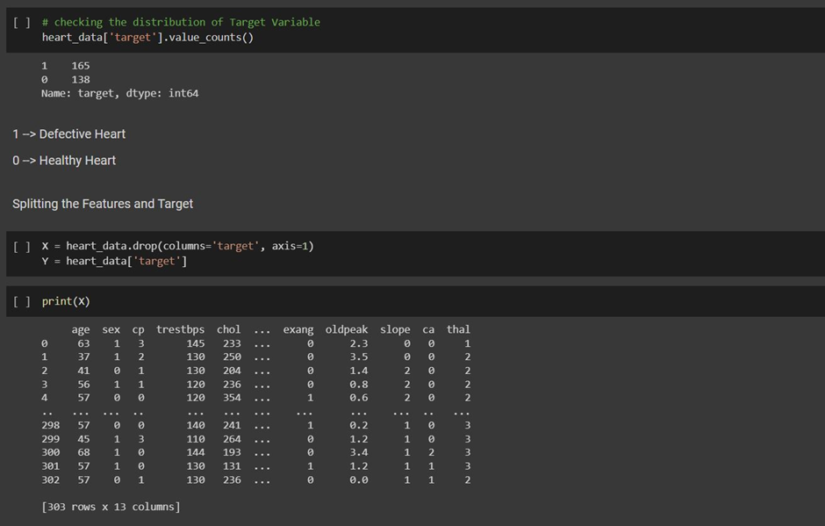
Code

Slide 21
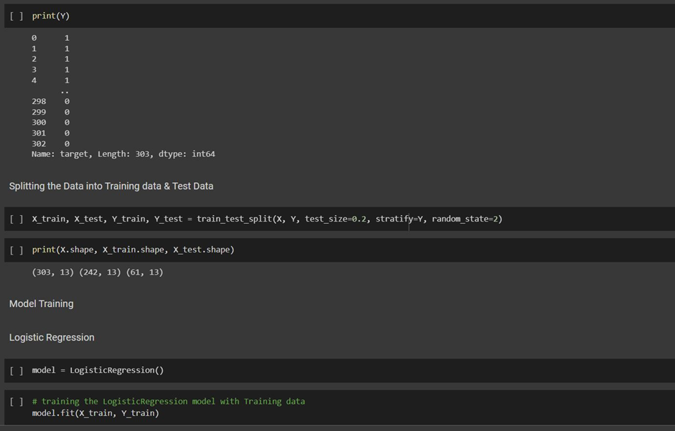
Code

Slide 22
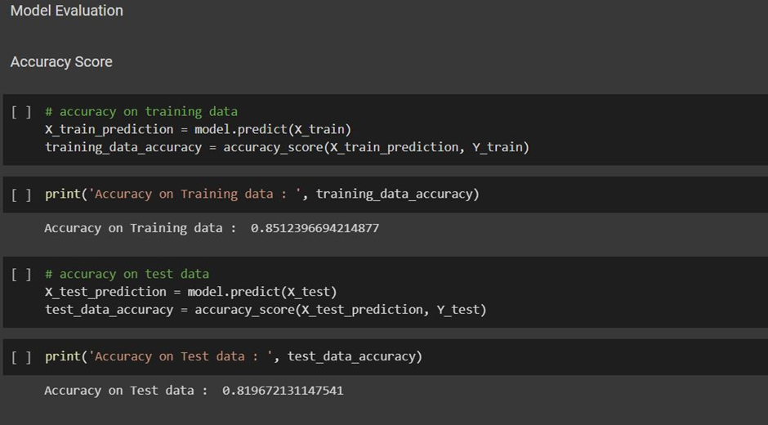
Testing

Slide 23
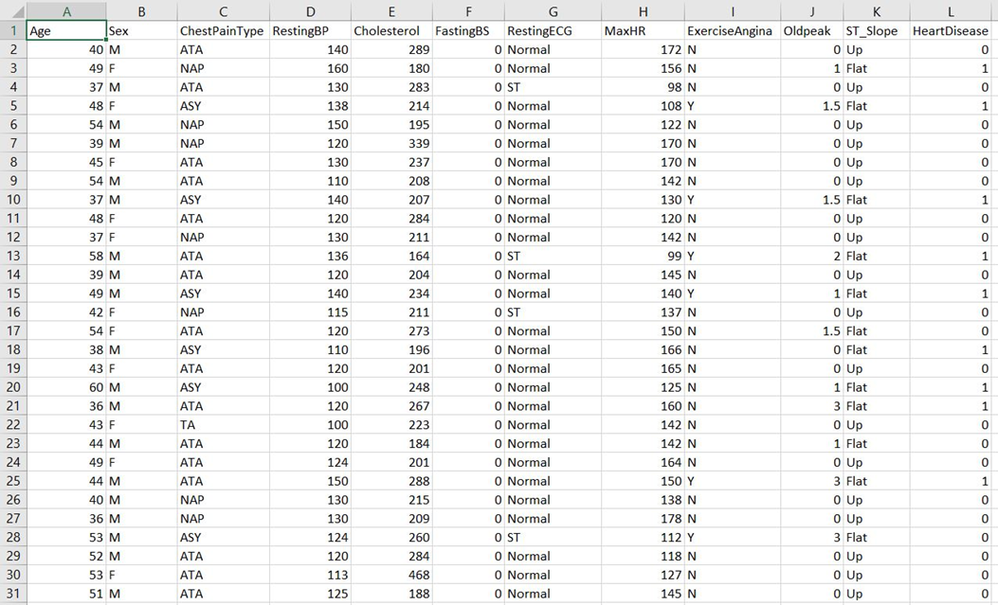
Dataset

Slide 24
Dataset
Factors Taken In Dataset
Age
Sex
Chest Pain Type
RestingBP – Resting Blood Pressure
Cholesterol
FastingBS - Fasting Blood Sugar
RestingECG - Resting Electrocardiogram
MaxHR - Max Heart Rate
Exercise Angina
Old Peak – ST depression induced by exercise relative to rest
ST Slope

Slide 25
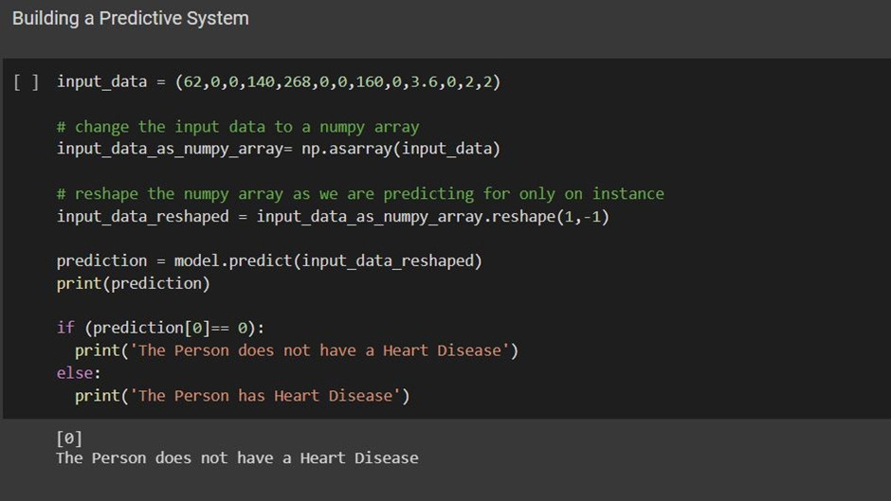
Result

Slide 26
Conclusion
Heart disease prediction systems can play an important role in improving the diagnosis and treatment of cardiovascular diseases. With the help of machine learning algorithms such as logistic regression, healthcare professionals can identify patients at risk of heart disease and provide timely interventions to prevent or manage the condition.
However, developing an accurate heart disease prediction system requires careful consideration of various factors such as data quality, feature selection, algorithm selection, and model evaluation. It is also important to ensure the system's reliability, interpretability, and scalability, while maintaining patient privacy and data security.
Despite these challenges, heart disease prediction systems have the potential to significantly improve the health outcomes of patients and reduce healthcare costs. By leveraging the power of machine learning and data analytics, we can work towards a future where heart disease is effectively prevented and managed, leading to better quality of life for individuals and communities.

Slide 27
References
Alizadehsani, R., Habibi, J., Hosseini, M. J., Mashayekhi, H., & Hosseini, S. M. (2017). Prediction of coronary artery disease using machine learning algorithms. CVD Prevention and Control, 12(3), 77-83.
Krittanawong, C., Zhang, H., Wang, Z., Aydar, M., & Kitai, T. (2018). Artificial intelligence in precision cardiovascular medicine. Journal of the American College of Cardiology, 71(23), 2668-2679.
Prasad, K. S., Choudhary, S. K., Jaiswal, M., Singh, A. R., & Bharti, S. K. (2020). Machine learning in predicting coronary artery disease: a systematic review. Journal of Medical Systems, 44(9), 1-10.
Zhang, Y., Jiang, C., Wang, X., Cai, D., & Zhu, H. (2019). Predicting coronary artery disease risk factors using deep learning. IEEE Access, 7, 154982-154989.
Liu, M., Yin, Y., & Wang, Y. (2020). Application of machine learning in predicting coronary artery disease. Journal of Healthcare Engineering, 2020, 1-9.

Slide 28
THANK YOU

